Slide 1
Topic: Mixing of Liquid in a Tank Controlled using PLC
Presented By: Madhusudhan K – 22070148004
Sagar Patel – 22070148006
Sayandip Paul – 22070148010
Neel Shah - 22070148011

Slide 2
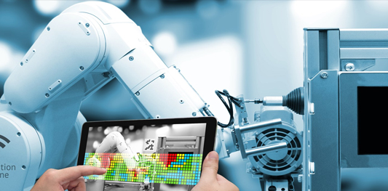
Topic To be Covered
Introduction
Problem Statement
Methodology
Components of a Mixing System
Programming the Mixing Process
HMI
Future Scope
Conclusion

Slide 3
Introduction
Mixing of liquid in a tank is a crucial process in various industries, including chemical, pharmaceutical, and food processing.
The quality of the final product depends on the efficiency of the mixing process.
In recent years, programmable logic controllers (PLCs) have become an essential component in controlling the mixing process. PLCs provide accurate and reliable control over the mixing process, resulting in consistent product quality.

Slide 4
Problem Statement
The problem statement involves the control of mixing of liquid in a tank using a Programmable Logic Controller (PLC). The tank is equipped with a mixer, which is driven by a motor. The aim is to maintain a desired level of mixing intensity or concentration of the liquid in the tank.

Slide 5
Methodology
The procedure for managing liquid mixing in a tank with a PLC is broken into many steps:
The first stage is to specify the mixing requirements, which include the intended mixing intensity or concentration of the liquid in the tank. This data is essential for creating the control algorithm.
Install sensors: The next stage is to install sensors that can monitor the present strength of the mixing and the flow rate of the liquid being poured to the tank. Depending on the application, these sensors can be flow metres, pH metres, conductivity metres, or other sorts of sensors.

Slide 6
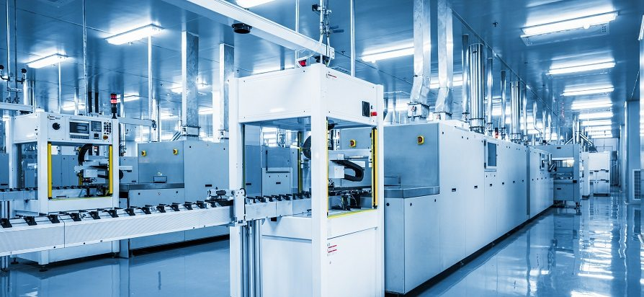
The following step is to programme the PLC with the control algorithm. To maintain the correct mixing intensity, the algorithm should read the sensor data and modify the speed of the motor that powers the mixer correspondingly. The algorithm should also include safety elements to prevent the liquid from being over- or under-mixed.
Test the system: Once the PLC has been programmed, the system must be tested. This entails operating the mixer with the liquid in the tank and measuring the strength of the mixing. Based on the sensor data, the PLC should change the motor speed to maintain the appropriate mixing intensity.

Slide 7
Components of a Mixing System
The components used in PLC project are as follows:
1. Delta PLC DVP14SS2.
2. Solenoid Valve – 24V.
3. Level Sensors.
4. SMPS – 24V.
5. DC Motor.
6. Relay.
7. Containers for liquids.

Slide 8
Delta PLC DVP14SS2:
The delta PLC will help us to connect each and all sensors and actuators.
There are 7 input and 7 output modules.
It has RS485 Communication Protocols.
It is simple to interface with the laptop or Pc.
Load your ladder diagram and it will start work accordingly.

Slide 9
Solenoid Valve:
A solenoid valve is an electrically controlled valve. The valve features a solenoid, which is an electric coil with a movable ferromagnetic core (plunger) in its centre. In the rest position, the plunger closes off a small orifice. An electric current through the coil creates a magnetic field.

Slide 10
Level Sensors:
Level Sensors are used to detect the level of substances that can flow. Such substances include liquids, slurries, granular material and powders. Level measurements can be done inside containers or it can be the level of a river or lake.

Slide 11
Programming the Mixing Process

Slide 12
HMI(Human machine interface)

Slide 13
Future Scope
The future potential of employing a PLC to manage liquid mixing in a tank is large and intriguing. The use of PLCs for mixing control is projected to become increasingly common and complex as technology advances and the demand for efficient and dependable industrial processes grows.
Future breakthroughs in this sector might include:
Integration of artificial intelligence (AI) and machine learning algorithms: with PLCs for mixing control can result in more accurate and optimised control algorithms that can learn and adapt to changing conditions, resulting in even more efficient and consistent mixing.

Slide 14
Wireless sensor networks: can minimise the cost and complexity of installing and maintaining sensors, allowing for real-time monitoring of the mixing process from a remote location.
Cloud-based control systems: Using cloud-based control systems allows for greater flexibility and scalability when controlling numerous mixing operations across several sites.
Predictive maintenance approaches, such as machine learning algorithms, can assist forecast when maintenance is needed for the mixing system, decreasing downtime and lowering the risk of equipment failure.

Slide 15
Conclusion
Finally, employing a PLC to regulate the mixing of liquid in a tank has various advantages in terms of efficiency, precision, and consistency. Based on the current level of mixing intensity and the flow rate of the liquid being added to the tank, the control system can accurately and continuously adjust the speed of the mixer motor to maintain the desired mixing intensity, ensuring consistent quality of the product being produced, reducing waste, and improving efficiency.

Slide 16


